Slide 1
QLORA: Efficient Finetuning of Quantized LLMs
Faculty of Computer Science
Data Science
Muhammad Asad
Conference: NeurIPS 2023

Slide 2
The Problem
Data Science
Developing LLM
The Reality:
Consumer GPUs: 8-24 GB VRAM
Professional GPUs (A100): 40-80 GB VRAM
Fine-tuning 65B model: Requires 780+ GB for optimizer states!
Model Size | Parameters | FP32 Memory | FP16 Memory
LLaMa-7B | 7B | 28GB | 14GB
LLaMa-13B | 13B | 52GB | 26GB
LLaMa-65B | 65B | 260GB | 130GB

Slide 3
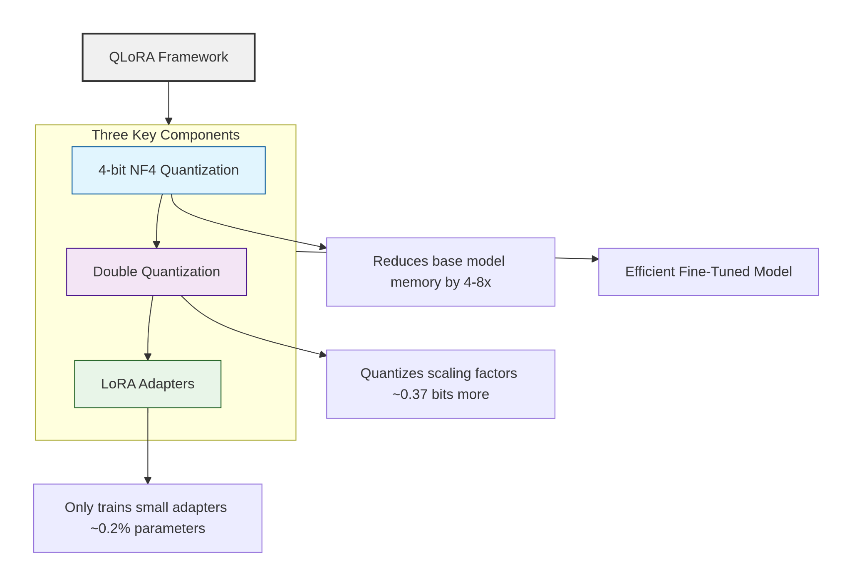
QLoRA
Data Science
Developing LLM

Slide 4
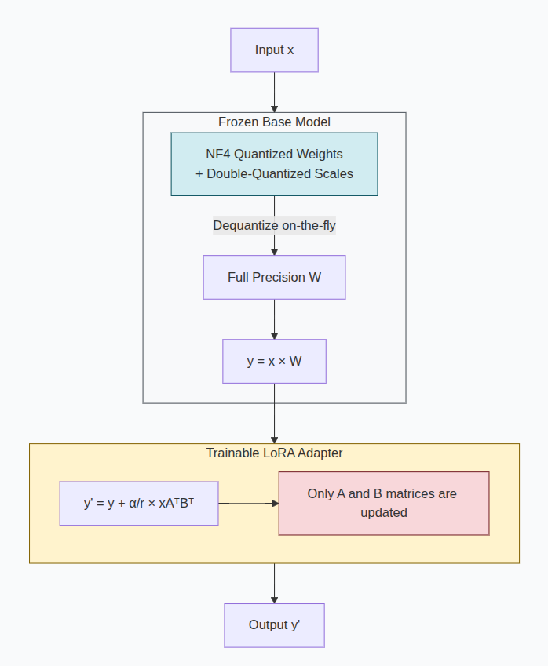
How it Works
Data Science
Developing LLM
Memory During Training:
Base weights: **4-bit** (frozen, quantized)
LoRA weights: **16-bit** (trainable, ~0.2% of total)
Gradients: Only for LoRA parameters
Optimizer states: Only for LoRA parameters

Slide 5
Methodology and Experiments
Data Science
Developing LLM
Conclusion
NF4 Data Type: Novel 4-bit quantization optimized for normally distributed weights
Double Quantization: Secondary quantization of scaling factors for additional compression
Paged Optimizers: CPU↔GPU memory paging for optimizer states
Experiments
Guanaco Model Family: State-of-the-art chatbots fine-tuned with QLoRA
Guanaco-65B reaches 99.3% of ChatGPT performance
Trained on single GPU in 24 hours
Systematic Study: 1,000+ model evaluations across different configurations

Slide 6
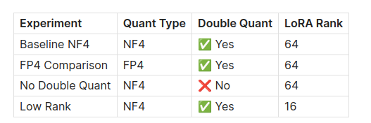
Experimental Setup
Data Science
Developing LLM
Original Implementation Test:
Model: TinyLlama-1.1B-Chat
Dataset: Alpaca (instruction following)
Training: 50 steps with gradient checkpointing
Hardware: GPU with CUDA support
Metrics Collected:
Quantization Error (Mean Absolute Error)
Memory Usage (GPU allocated)
Training Loss
Training Time

Slide 7
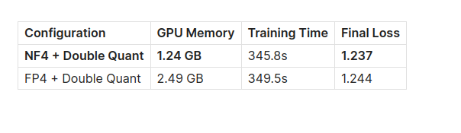
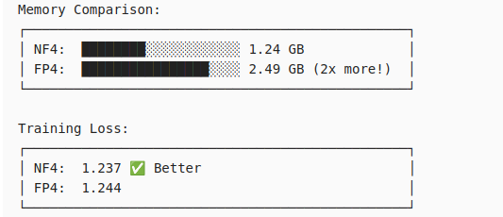
Results Training Performance
Data Science
Developing LLM
LoRA Parameter Efficiency:
Total Parameters: 666,068,992
Trainable (LoRA): 50,462,720
Notes:
hello how are you

Slide 8
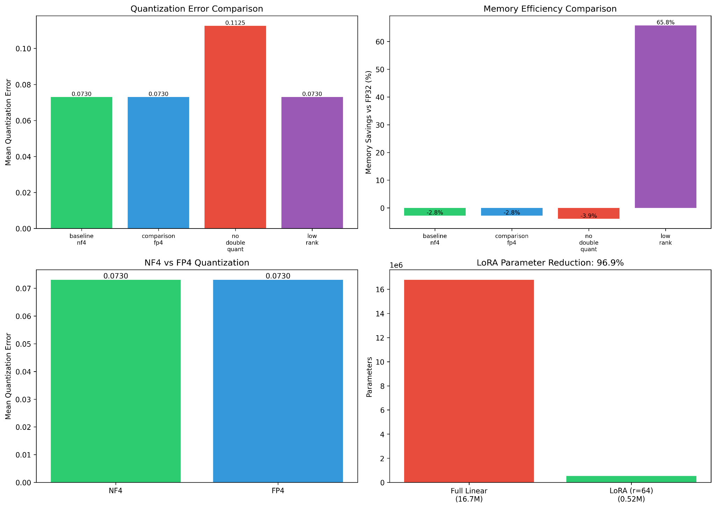
Experimental Results Visualization
Data Science
Developing LLM
Quantization Error (Top Left): NF4 and FP4 tie; No-DQ has 54% more error
Memory Efficiency (Top Right): Low-rank LoRA (r=16) achieves 65.8% savings
NF4 vs FP4 (Bottom Left): Essentially equal in our synthetic tests
LoRA Reduction (Bottom Right): 96.9% parameter reduction with r=64

Slide 9
Limitations
Data Science
Developing LLM
Inference Speed: Quantized models may have slower inference due to dequantization overhead
Hardware Dependency: Optimal performance requires specific GPU support for 4-bit operations
Task Complexity: Very complex tasks may need higher LoRA ranks, reducing efficiency gains
Catastrophic Forgetting: Like all fine-tuning, risk of forgetting pre-training knowledge

Slide 10
Conclusion
Data Science
Developing LLM
Implementation Takeaway
  Built complete QLoRA from scratch: NF4, Double Quant, LoRA
  Verified theoretical memory savings in practice
  Confirmed NF4 outperforms FP4 in memory efficiency
  Understanding the algorithms deepens appreciation for the elegance

